Slide 1
Switch statements and Exception Handling

Slide 2
Today’s agenda
Last time
Today
Creating re-usable code with static methods
Don’t Repeat Yourself
Variable scoping and static methods
The stack
Switch statement.
Alternative to if…else if…else ladder
Errors and an introduction to Exception Handling
Different types of errors you will encounter
Checked and unchecked errors
try/except/finally blocks

Slide 3
Switch statement
Sometimes the if statement is just too much…

Slide 4
Multi-way selection
Consider a program that uses a number 1 to 7 to process a day of the week : 1 is Sunday, 2 is Monday etc.
To print the day associated with the number, we could try:
if (day == 1)
{
System.out.println("Sunday");
}
else if (day == 2)
{
System.out.println("Monday");
}
else if (day == 3) // ... etc

Slide 5
The switch statement
Allows multi-way selection, based on an int, a char and a String value
Saves complex if… else-if statements.
Switch statements do not work when branching depends on variables of type double, boolean or other types of objects.

Slide 6
switch statement
switch (expression) // expression may be single int, a char variable or a String variable
{
case value1:
s1;
s2;
s3;
break;
case value2:
s4;
s5;
s6;
break;
case value3:
s7;
break;
default:
s8;
}
Notice, no { } around these statements
break forces an exit from the switch construction
Optional default label/section:
handles values that have not been explicitly handled by one of the case statements.
no need for a break here (because it is the last branch)
The expression should match one of these values

Slide 7
switch Example
int day;
// statements assigning a value to day.
switch(day)
{
case 1: System.out.println("Sunday");
break;
case 2: System.out.println("Monday");
break;
case 3: System.out.println("Tuesday");
break;
case 4: System.out.println("Wednesday");
break;
case 5: System.out.println("Thursday");
break;
case 6: System.out.println("Friday");
break;
case 7: System.out.println("Saturday");
break;
default: System.out.println("Oops: an invalid day number");
} // end of switch
System.out.println("proceeding with rest of program");

Slide 8
Notes on switch
The expression must yield an integer, a char or a String value.
default label is optional, but is required if no case label match exists.
break is needed to prevent statements from subsequent case label(s) being executed.
Can have the same statements for more than one case label, but duplicate case labels are not allowed.
Order of listing the case labels is normally unimportant.

Slide 9
Further switch example
int daynumber ; // assume this has a value 1-7, 1 for Sunday etc.
switch(daynumber)
{
case 2 : // days Mon, Tue, Thur, Fri
case 3 :
case 5 :
case 6 : System.out.println("End at 17.30");
break;
case 4 : System.out.println("Half-day, end at 12.00");
break;
case 7 :
case 1 : System.out.println("Weekend (Closed)");
break; default: System.out.println("day out of range");
}

Slide 10
Over to you – Putting it all together !
Write a menu-driven program that provides three options:
Option 1 allows the user to enter a temperature in Celsius (C) and displays the corresponding Fahrenheit (F) temperature.
Option 2 allows the user to enter a temperature in Fahrenheit (F) and displays the corresponding Celsius (C) temperature.
Option 3 allows the user to quit.
The formulae are: F = 9 / 5 x C + 32 C = 5 x (F – 32) / 9
Adapt your program so that the user is not allowed to enter a temperature below absolute zero (this is -273.15 C or -459.67 F)
Input must be validated to make sure only one of the three options is allowed.
Finally, the user must be able to enter a new temperature until option 3 is entered.

Slide 11
Types of error
Wait, there’s more than one?

Slide 12
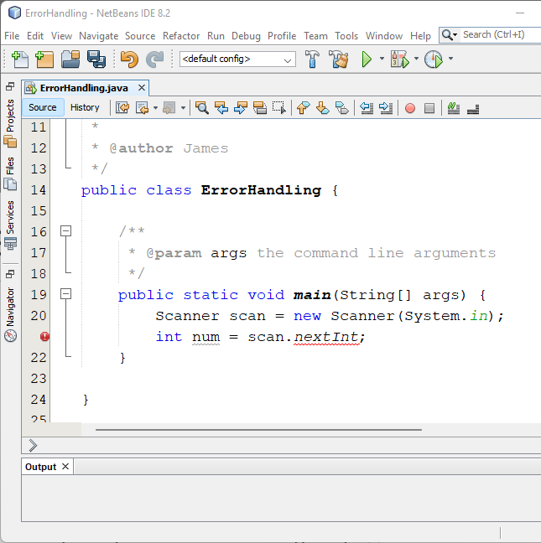
Syntax errors
Also known as compile-time errors.
These prevent compilation because they violate the rules for how to write Java code.
Often these are language or grammar infringements.
They’re relatively easy to detect:
In Netbeans 8.2, syntax errors are highlighted in red.
Code with syntax errors will not compile into Java bytecode.
Notice the missing brackets?

Slide 13
Common Java syntax errors
Brackets are the main cause:
Or, it could be…
Improper matching of quotation marks or parentheses:
Missing the opening/closing of “” or ().
Using incorrect brackets [] {} ().
These errors often won’t be caught until the next line!
Misspelling key words or variable names.
Using a reserved word as a variable name.
Mismatching variable name types with data or during processing.
Forgetting semi-colons.
Improper use of { } can lead to both:
Runtime errors.
Logic errors.

Slide 14
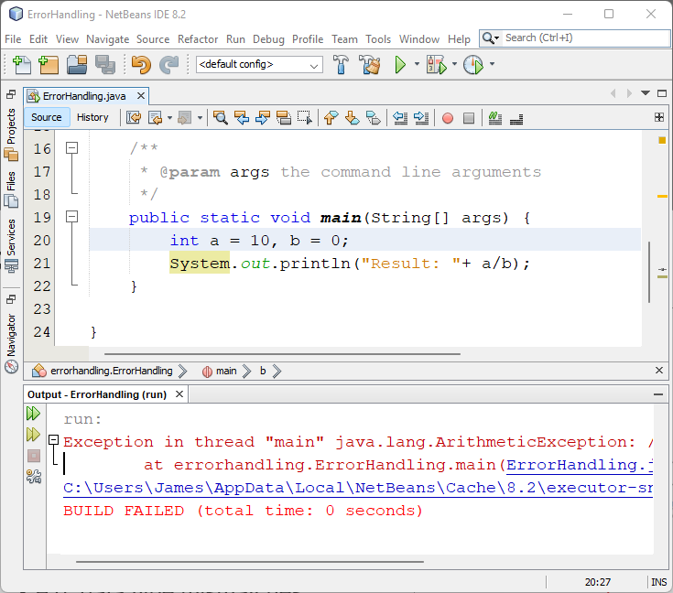
Runtime errors
Do not infringe syntax rules but cause exceptions when the program runs. Hence, the program fails during runtime.
Most common cause of runtime errors is programmer error!
All but the simplest programs need to handle exceptions:
Data type mismatches.
Index out of bounds exceptions on sequences.

Slide 15
Logic errors (part 1.)
Logic error do not cause syntax or runtime errors, but the program still yields incorrect results! These are the hardest to debug by far.
Often caused by:
Programmer logic error (failing to think through a procedure correctly).
Programmer failure to properly code algorithm used (algorithm works but code is badly written).
Programmer may not properly understand the algorithm or procedure.
One of the most common errors faced by new programmers is the mixing up of and/or conjunctions in conditional statements. Look at the brackets in the following example carefully.

Slide 16
Logic errors (part 2.)
What I initially wrote…
What I meant…
public static void main(String[] args) {
Scanner scan = new Scanner(System.in);
System.out.print("Enter citizenship: ");
String cit = scan.nextLine();
System.out.print("Enter age: ");
int age = scan.nextInt();
if (age > 18 && // new line for reading
cit.equals("UK") || cit.equals("GB"))
{
System.out.println("You can vote!");
}
else
{
System.out.println("Cannot vote.");
}
}
public static void main(String[] args) {
Scanner scan = new Scanner(System.in);
System.out.print("Enter citizenship: ");
String cit = scan.nextLine();
System.out.print("Enter age: ");
int age = scan.nextInt();
if (age > 18 && // new line for reading
(cit.equals("UK") || cit.equals("GB")))
{
System.out.println("You can vote!");
}
else
{
System.out.println("Cannot vote.");
}
}

Slide 17
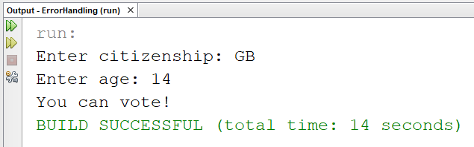
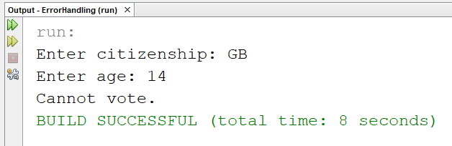
Logic errors (part 3.)
What happened…
What I wanted to happen…

Slide 18
Exceptions
Handling the unexpected.

Slide 19
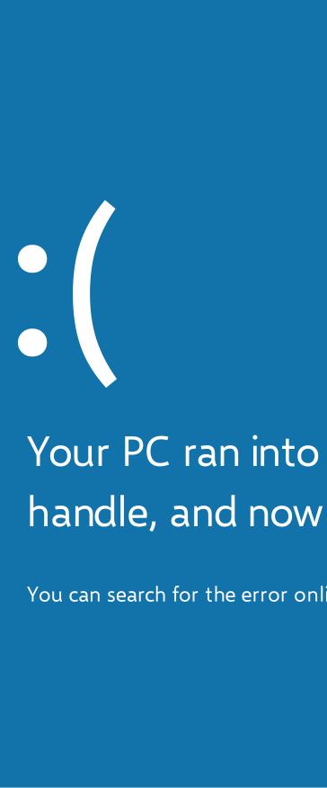
Handling unexpected situations (part 1.)
We want to build software that is reliable and robust.
Our programs must be able to deal with things going wrong without crashing.
Some errors can be predicted and coded for:
For example: user inputting an invalid option choice.
Other errors may be unpredictable: exceptional conditions, system errors, etc.

Slide 20
Handling unexpected situations (part 2.)
What happens?
If a program tries to read an integer, but text is input:
Scanner keyboard = new Scanner(System.in);
int num = keyboard.nextInt();
If a number is divided a number by zero:
int count = 0;
int total = 0;
double average = total / count;

Slide 21
Handling unexpected situations (part 3.)
If a program tries to read an integer, but text is input an input mismatch Exception occurs:
Please enter an integer: ten
Exception in thread "main" java.util.InputMismatchException
at java.base/java.util.Scanner.throwFor(Scanner.java:939)
at java.base/java.util.Scanner.next(Scanner.java:1594)
at java.base/java.util.Scanner.nextInt(Scanner.java:2258)
at java.base/java.util.Scanner.nextInt(Scanner.java:2212)
at App.main(App.java:8)

Slide 22
Dealing with exceptions (part 1.)
Java provides exception classes, which will detect an error event.
The java runtime environment determines which exception has occurred and an object of the given class is generated. This process is known as throwing an exception.
These exception classes have been named to reflect the nature of the exception:
ArrayIndexOutOfBoundsException
InputMismatchException
NumberFormatException
…
Notes:
Throwing an object means that this exception object can be caught or passed on to someone else, a bit like a rugby ball

Slide 23
Dealing with exceptions (part 2.)
Exceptions are not unconditionally fatal!
We can either write our own code to deal with the consequences of an event or let the Java Runtime display an error message and terminate the program.
A well designed and written program will include code to trap runtime errors:
use if-else to check that an object has been instantiated,
use loop statements until valid input is received when appropriate,
provide default statement in a switch statement,
…

Slide 24
Java has two types of exceptions
Checked exceptions
Unchecked exceptions
The programmer must declare these in a method (e.g. throws) or write code to deal with these.
The compiler will check to see if we have done this.
Most I/O events are checked (e.g. exceptions such as keyboard locked, file corrupt, etc.)
The compiler does not check for these.
We can decide ourselves if we want to write code to catch these or let them be thrown further.
Often exceptions may be avoided, but will lead to program failing (e.g. input mismatch, divide by zero, array out of bounds, etc).
Note ‘Checked’ here refers to whether the given exception is checked by the compiler or simply ignored.

Slide 25
Summary of Checked and Unchecked exceptions
Throwable
Exception
Error
IOException
RunTimeException
AWTError
ThreadDeath
VirtualMachine
FileNotFoundException
ClassCastException
NullPointerException
ArithmeticException
Key
IndexOutOfBoundsException
NoSuchElementException
CHECKED
ArrayIndexOutOfBoundsException
InputMismatchException
UNCHECKED
Notes:
A sample of Java’s pre-defined exception class hierarchy
System errors (hard errors) - unchecked
IOExceptions, not the programmer’s responsibility, but unavoidable – checked
Runtime exceptions – totally the programmer’s responsibility – unchecked – deal with it !

Slide 26
Dealing with exceptions
Programmers must ‘deal’ with checked exceptions either by:
Declaring the Exception in the method that gives rise to the exception (called throwing the exception). We say that the method is claiming the exception, i.e. the method will pass on the exception that it might generate.
Writing code inside a method where the exception may occur to deal with it, using try-catch blocks.
Which methods have the checked exceptions?
The API will tell us.
The compiler (or NetBeans) will let us know.

Slide 27
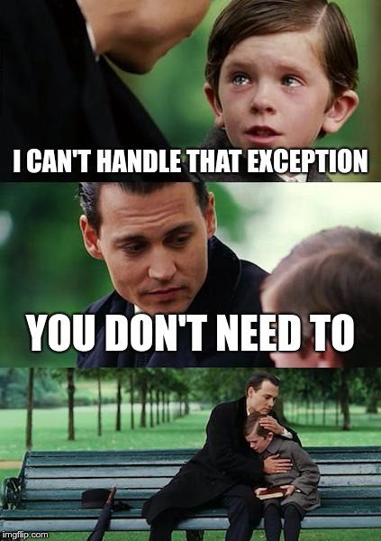
Throwing exceptions (part 1.)
If a method in which an Exception occurs does not handle the exception (i.e. catch the exception), then the method is terminated, and control goes back to the calling statement.
Ultimately the Exception will be thrown back to the main method, which, if it does not handle the exception, will be terminated
Causing the program in a most ungracious, undignified way ☺!

Slide 28
Throwing exceptions (part 2.)
A method that does not handle a checked exception must be declared with a ‘throws SomeException’ clause with the method (after the method header), and on any other method using or calling it.
public static void main (String[] args) throws IOException
{
// code...
methodA();
// more code...
}
static void methodA() throws IOException
{
// code...
methodB();
// more code...
}
static void methodB() throws IOException
{
/*
some code doing input, that may
cause an IOException
*/
}
Notes:
The ‘throws’ clause indicates that the caller of this method may receive an exception object
SomeException indicates the type of exception generated by .this method

Slide 29
Throwing exceptions (part 3.)
throws SomeException clause with try-catch:
public static void main (String[] args)
{
// code...
try {
methodA();
}
catch (IOException e)
{
// Handle exception
}
// more code...
}
static void methodA() throws IOException
{
// code...
methodB();
// more code...
}
static void methodB() throws IOException
{
/*
some code doing input, that may
cause an IOException
*/
}
Notes:
No throws
one throw in TestException + one import java.io.*
One throw in each of TestException and AptitudeTest + one import java.io.*
Run normally
Run with inputformat error, e.g. 12w

Slide 30
Catching exceptions
Attempt to deal with an exception using try-catch block.
try
{
// code that may cause an exception
}
catch (Exception e)
{
// action to recover from exception e
}
// carry on here if the method has not terminated
Notes:
Once an exception object is trapped in a catch block, and that block ends, the exception object is effectively terminated.

Slide 31
try-catch blocks
If no exceptions occur in the try block, the catch block(s) are ignored.
A catch block should be given specific exception to deal with as a parameter:
catch(NumberFormatException e) { }
catch(ArrayIndexOutOfBoundsException e) { }
catch(ArithmeticException e) { }
catch(Exception e) { }
Exceptions belong to a hierarchy of classes.
The class Exception is the most general of these classes and, if used, must come as the last catch clause.

Slide 32
try-catch blocks
Within the catch block, programmers can, if they choose, interrogate the exception object using some Exception methods, some of which are listed here:
Method | Description
printStackTrace() | Prints (to the console) a stack trace of the exception
toString() | Returns a detailed error message
getMessage() | Returns a summary error message
Notes:
AptitudeTest2.java, TestException.java

Slide 33
Multiple catch blocks
More than one exception can be thrown in a try block:
Each must have its own catch block.
Order of catch blocks is important!
To catch all possible exceptions:
catch(Exception e) { }
But... It’s not always very easy to find out what the exception was.

Slide 34
Using exceptions
Do not misuse Exception handling!
There is some performance/processing overhead in using exceptions.
Use logic tests rather than try-catch blocks for the unchecked exceptions. Use if-else where possible:
if (userinput < 0)
if (someObject != null)
if (myScannerObject.hasNextInt())
Exception handling should be reserved for the events that should not normally happen.

Slide 35
Text input and Scanner class (part 1.)
Text can be made up of any valid characters:
alphabetic, numeric, punctuation, space, newline, etc.
‘whitespace’ means new line, space, tab characters.
The Scanner class has methods to read text using one or more spaces as the delimiter.
next() reads the next text as a String.
nextLine() reads text to the end of the line (enter) as a String.
nextInt() reads the next text as an integer.
nextDouble() reads the next text as a double.

Slide 36
Text input and Scanner class (part 2.)
The Scanner method nextLine() reads a whole line (newline character is the delimiter) so spaces between ‘tokens’ can be included.
Scanner can ‘look ahead’ to see if there is more input to read, and if so, check the type of input.
hasNext() true if there is something else (a token) to read.
hasNextInt() true if the next ‘token’ is an integer.
hasNextDouble() true if the next ‘token’ is a double.
hasNextLine() true if there is another line to read.

Slide 37
Text input and Scanner class (part 3.)
Scanner throws unchecked exceptions
Which is better to trap input errors?
InputMismatchException wrong type of data input.
NoSuchElementException if input is exhausted.
To use try { } and catch() { } blocks.
To use the Scanner class hasNext() methods.

Slide 38
The finally clause (part 1.)
So, to summarise, three courses of action can take place in a try block:
The instructions within the try block are all executed successfully.
An Exception occurs within the try block; the try block is exited and a matching catch block is found for this exception.
An Exception occurs within the try block; the try block is exited but no matching catch block is found for this exception; so the exception is thrown from the method.

Slide 39
The finally clause (part 2.)
It may be that, no matter which of these courses of action takes place, you wish to execute some additional instructions before the method terminates.
Often, such a scenario arises when you wish to carry out some clean-up code, such as closing a file or a network connection that you have opened in the try block.
The finally clause allows us to do this. The syntax for the finally clause is shown on the next slide.

Slide 40
The finally clause (part 3.)
try
{
// code that may cause an exception
}
catch (Exception e) /* if one or more ‘catch’ clauses
are specified, they must be
given before the ‘finally’ clause */
{
// action to recover from exception e
}
finally
{
// cleanup code goes here
}
// other instructions could be placed here

Slide 41
Courses of action
Three courses of action can now take place in a try block:
The instructions within the try block are all executed successfully; if there are any catch blocks specified, they are skipped and the code in the finally block is executed.
An Exception occurs within the try block; the try block is exited and a matching catch block is found for this exception, after which the code in the finally block is executed.
An Exception occurs within the try block; the try block is exited but no matching catch block is found for this exception; so, the code in the finally block is executed – after which the Exception is thrown from the given method.

